Slide 1
Support and resistance
Pukar Sharma

Slide 2
Overview
Support and Resistance
How Price reacts on S/R
Types of Support and Resistance
Demand and Supply

Slide 3
Support and resistance
Support is a price level where a stock tends to find buying interest as it falls.
It is a level where the price tends to stop falling and may bounce back up.
Resistance is a price level where a stock tends to find selling interest as it rises.
It is a level where the price tends to stop rising and may fall back down.

Slide 4
Resistance
Support

Slide 5
Resistance
supports holds the price
Support

Slide 6
Support

Slide 9
Break of Previous Resistance
Break of Previous Resistance
Previous resistance changes its nature to support and holds the prices
Previous resistance changes its nature to support and reverse the prices
Previous resistance changes its nature to support and reverse the prices

Slide 10
How many types of support and resistance
DEMAND AND SUPPLY ZONE
TRENDLINE SUPPORT AND RESISTANCE
PSYCHOLOGICAL POINTS
FIBONACCI S/R
INDICATOR S/R
FAIR VALUE S/R
CHANGE OF POLARITY

Slide 11
1. demand AND SUPPLY
In the Bull market, Demand zones are strong Support.
In the Bear market, Supply zoned are strong Resistance.
Demands and Supply zones:
where buying pressure is strong [DEMAND]
where selling pressure is strong [SUPPLY]

Slide 13
Three times the demand zone acts as a support
Demand is created as it spend lots of times and breakout
Demand Zone
In future if the price come here it have a chances of reversals
Demand Zone

Slide 14
Nature of demand and supply
Higher Timeframe Significance:
When analysing D/S zones on higher timeframes, like weekly charts, they often hold more weight.
Duration Matters:
Zones where the price lingers longer tend to be more impactful.
Ranging Markets: When a stock is trading in a range, it might be accumulating D/S.
Quick Price Movements
Notes:
Higher Timeframe Significance:
When analyzing D/S zones on higher timeframes, like weekly charts, they often hold more weight.
This is because they reflect longer-term buying or selling interest, making them more reliable for spotting potential price movements.
Duration Matters:
Zones where the price lingers longer tend to be more impactful.
The extended time in a D/S zone usually means that the market is absorbing pressure, which can shake out weaker traders and strengthen the zone.
Ranging Markets: When a stock is trading in a range, it might be accumulating D/S.
Once the price breaks out of these ranges, it often leads to significant moves due to the buildup of pressure during the range.

Slide 15
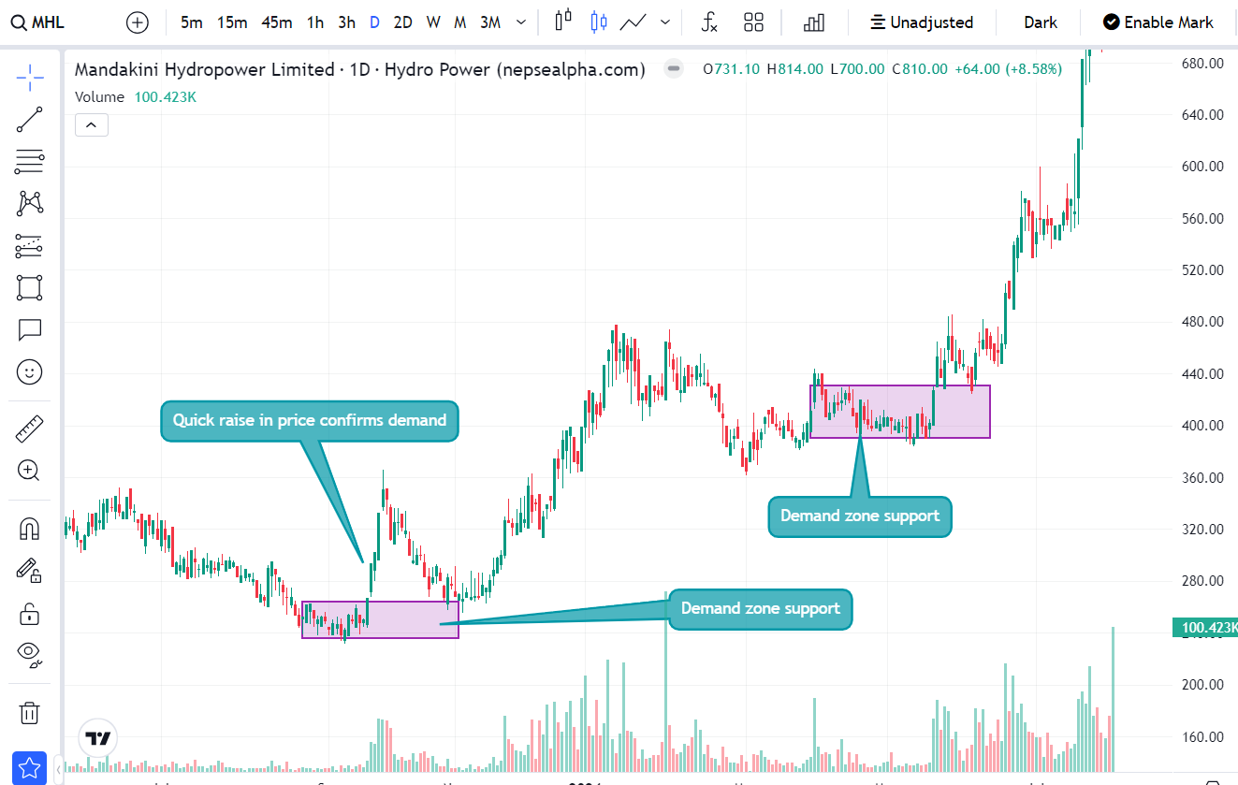

Slide 16
Trendline S/r
Trendline resistance
Trendline resistance
Trendline resistance
Trendline support
Trendline support

Slide 17
Assignments
Ten NEPSE Stocks with S/R ?
Five stock with Demand zone acts as a support.

Slide 18

THANK YOU
Pukar Sharma
sharmapukar98@gmail.com

